Slide 1
IBM University Engagement Project Submission
“Exploring the Power of Machine Learning with IBM Cloud”

Slide 2

Project Tile – [ SecureNet AI ]
Domain of Project – [ Network Security ]
Student Name | Recent Passport Photo | Email ID | Mobile number [WhatsApp]
Vanteru Bhuvan Reddy |  | bhuvanreddy682006@gmail.com | +91 6301901633

Slide 3
Problem Statement -
Problem Statement – Network Intrusion Detection
Develop an intelligent Network Intrusion Detection and Response System (NIDRS) capable of identifying malicious network activities and distinguishing them from normal network traffic. The system should analyse network traffic patterns using machine learning techniques to detect cyber-attacks such as DoS, Probe, R2L, and U2R attacks. Beyond detection, the solution should provide early threat warnings, explain attack behaviour, retrieve historical incidents, recommend mitigation strategies, and support autonomous security operations. The objective is to improve network security through accurate threat detection, intelligent decision-making, and real-time incident response. The system should be scalable for home networks, educational institutions, startups, and enterprise environments.

Slide 4
Proposed Solution -
We propose SecureNet AI, an AI-powered Autonomous Network Intrusion Detection and Response System (ANIDRS) using IBM watsonx.ai Studio, AutoAI, and the IBM Granite model.
Network traffic data containing features such as protocol type, service, connection flags, packet counts, and host statistics will be collected and uploaded to IBM watsonx.ai Studio.
IBM AutoAI will automatically perform data preprocessing, feature engineering, algorithm selection, model training, and hyperparameter optimisation to build the best-performing intrusion detection model.
The selected model will classify network traffic as Normal or Anomalous and provide high-confidence threat predictions.
IBM Granite-powered AI agents will further analyse detected threats, explain attack behaviour, retrieve similar historical incidents, perform risk assessment, generate mitigation strategies, and create executive security reports.
The system will support real-time monitoring, historical attack comparison, threat intelligence mapping, digital twin visualisation, SOC case management, and autonomous incident response assistance.
The proposed solution aims to provide an intelligent, explainable, and scalable AI-powered Security Operations Centre (SOC) assistant for home networks, educational institutions, startups, and enterprise environments.

Slide 5
Technology Used
IBM Cloud – It provides the infrastructure to build, deploy, and scale the SecureNet AI platform efficiently. IBM Cloud enables a secure, reliable, and scalable environment for deploying the autonomous multi-agent Security Operations Centre (SOC) assistant.
IBM watsonx.ai Studio (AutoAI) – Used for automated machine learning model development, feature engineering, model selection, hyperparameter optimisation, and deployment of the Network Intrusion Detection model.
IBM watsonx Granite Model – Used for AI-powered threat reasoning, explainability, historical analysis, mitigation planning, and SOC copilot functionalities.
ML Algorithm/ Model Used: IBM AutoAI Optimised Snap Decision Tree Classifier (Binary Classification: Normal vs Anomaly)
Accuracy Obtained: 99.5% (Cross-Validation Accuracy)
Enhancements and Hyperparameter tuning: IBM AutoAI HPO-1, automated feature engineering, feature selection, hyperparameter optimisation, XAI analysis, historical memory retrieval, and multi-agent threat reasoning using IBM Granite.

Slide 6
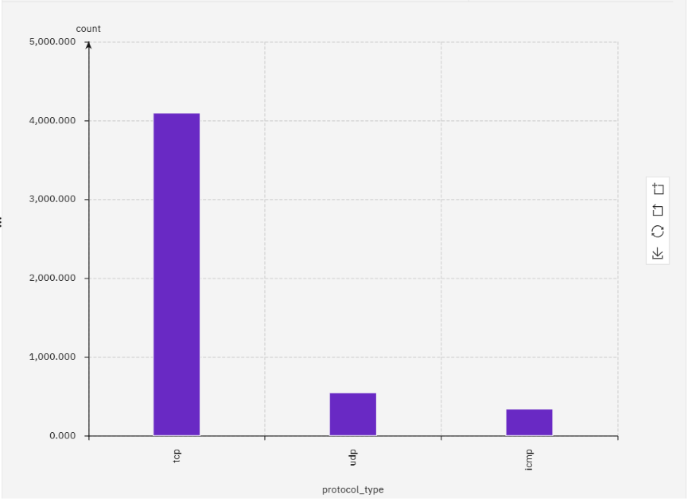
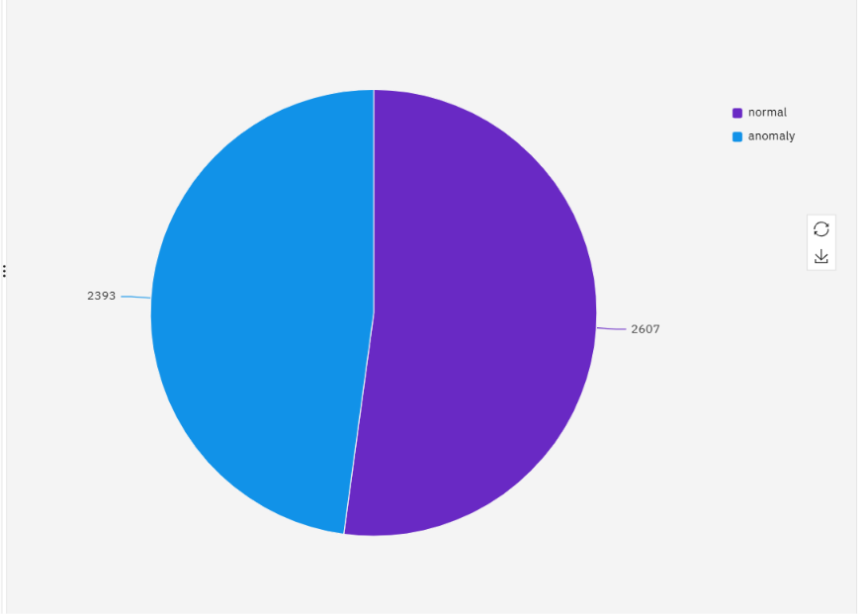
Dataset Analysis & Visualisation
Figure 2: Distribution of Network Protocol Types
Figure 1:Class Distribution (Normal vs Anomaly)

Slide 7
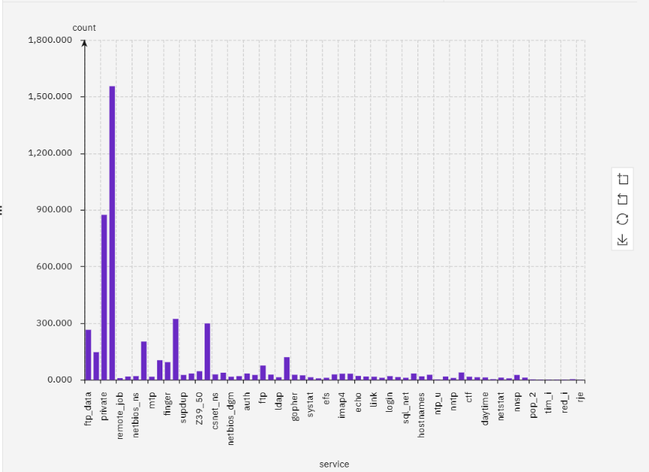
Figure 3: Distribution of Network Services

Slide 8
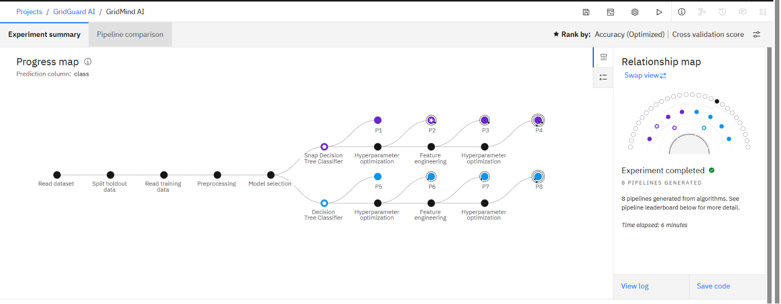
Training Screenshots-
Figure 4: Progress map

Slide 9
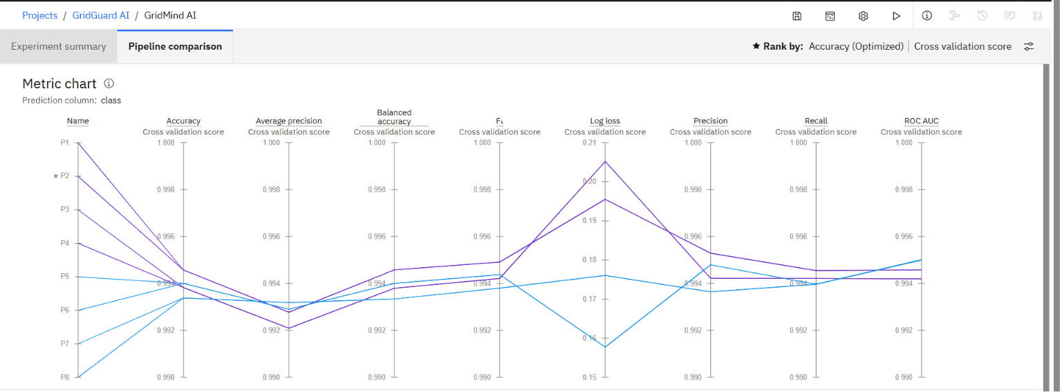
Figure 5: Pipeline comparison

Slide 10
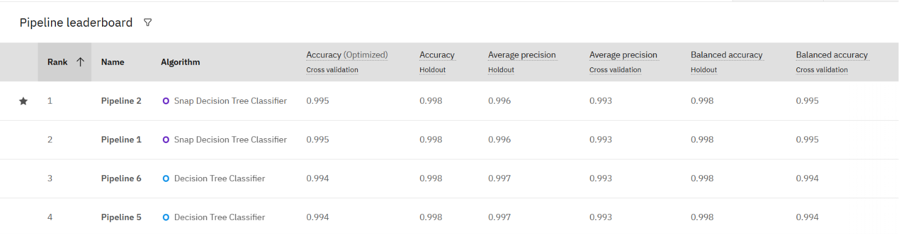
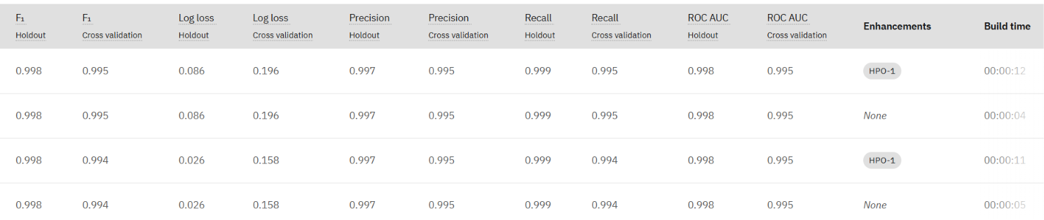
Best Model Screenshot:
Figure 6: Pipeline leaderboard

Slide 11
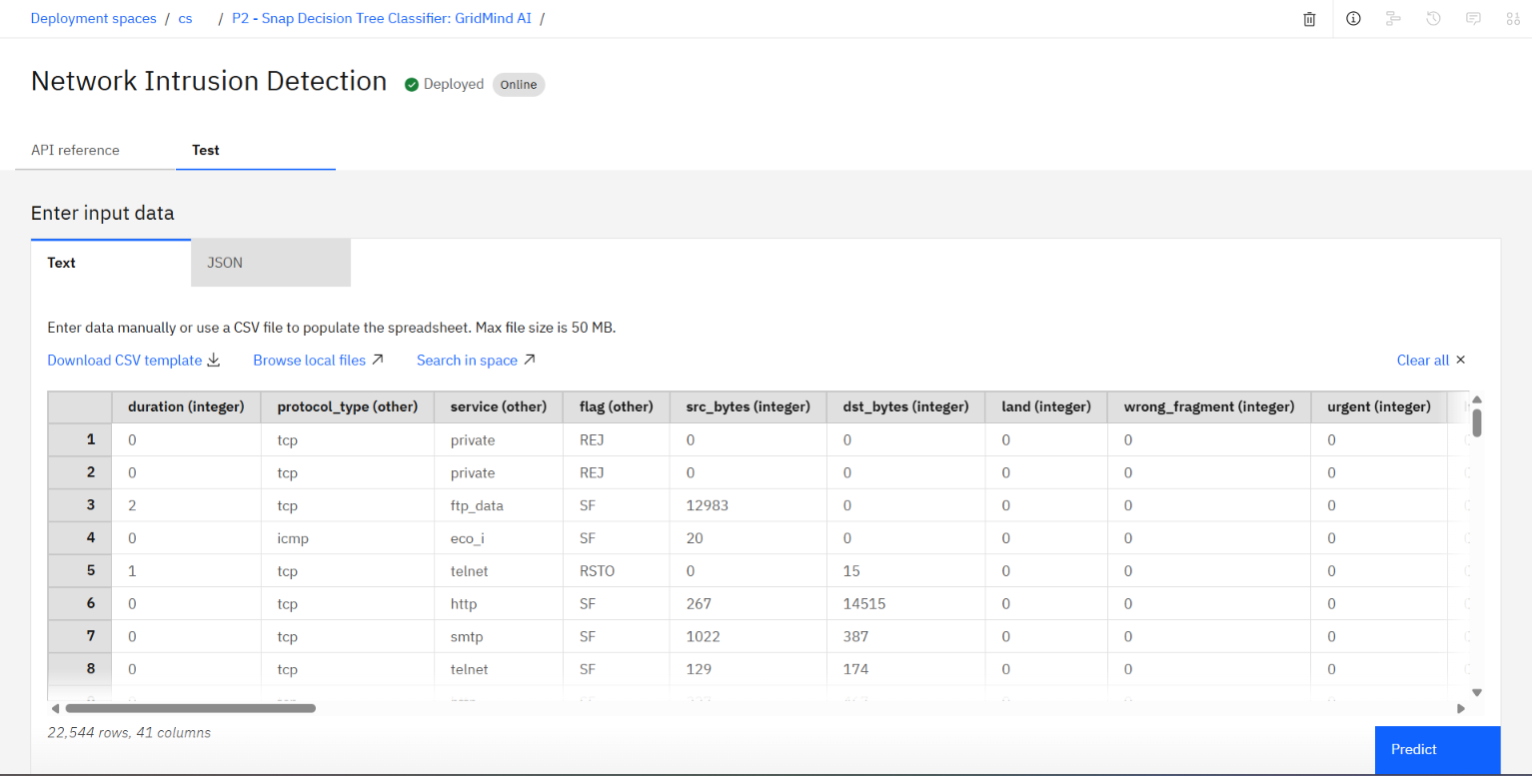
Testing Screenshot:
Figure 7: Test

Slide 12
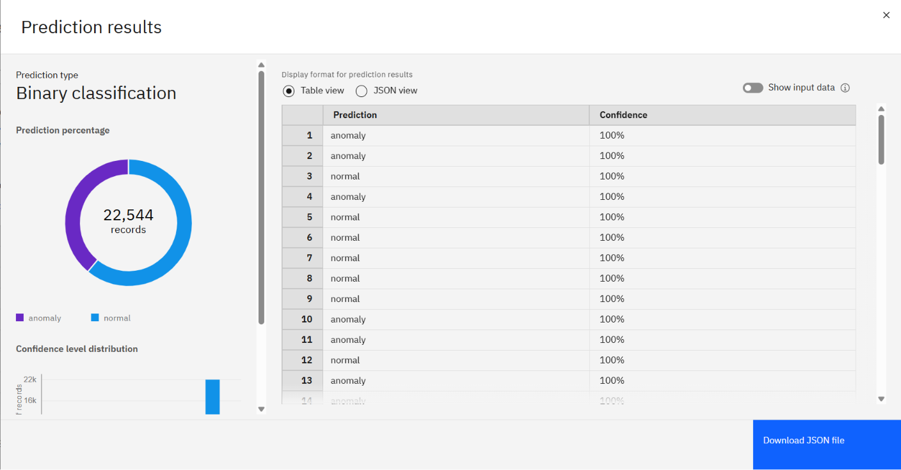
Testing Screenshot:
Figure 8: Results

Slide 13
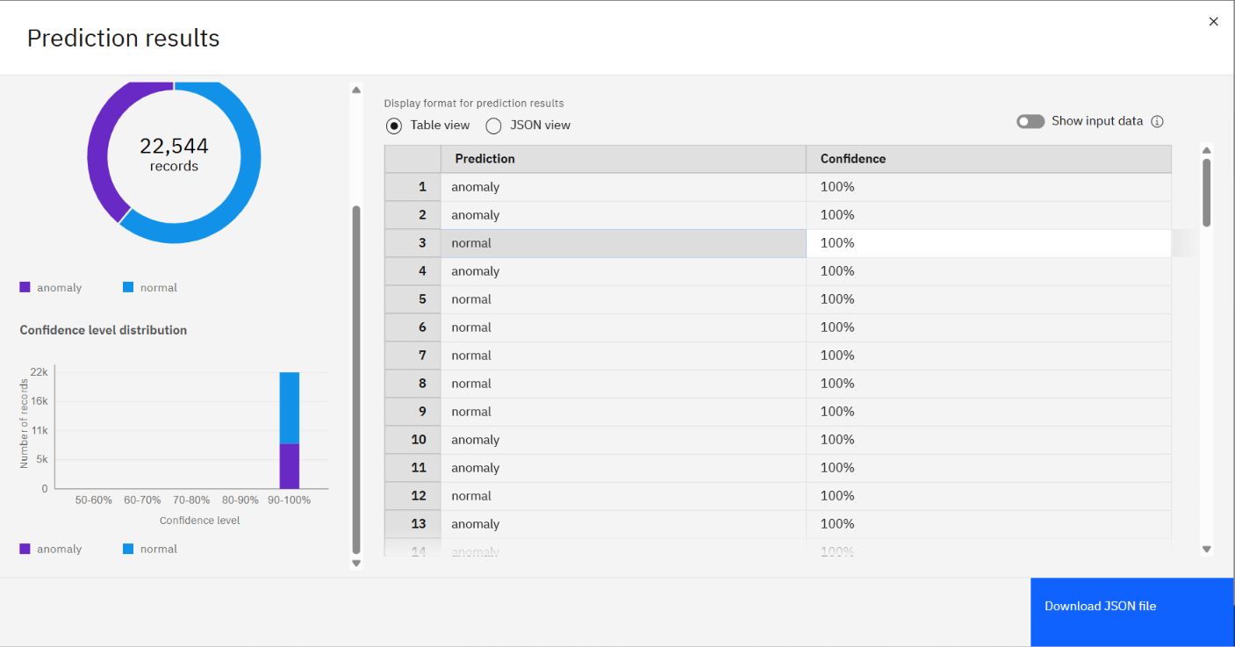
Figure 9: Results

Slide 14
Novelty and Uniqueness
SecureNet AI combines IBM AutoAI-based intrusion detection with IBM Granite-powered multi-agent reasoning, moving beyond traditional machine learning prediction systems.
The platform performs real-time cyber threat detection, analysis, and autonomous decision support through an AI-powered Security Operations Centre (SOC).
A historical memory engine compares current attacks with previously detected incidents and automatically recommends successful mitigation strategies.
The system provides Explainable AI (XAI) to justify every anomaly prediction using feature importance and decision paths.
A unique Cyber Digital Twin visualises attack propagation, detection, mitigation, and recovery across network infrastructures.
The platform supports multi-organisation environments, including home networks, educational institutions, startups, and enterprise SOCs.
Unlike conventional NIDS solutions, SecureNet AI transforms real-time predictions into autonomous reasoning, historical comparison, mitigation planning, and actionable security intelligence.

Slide 15
Git Hub Link
Github URL – https://github.com/Bhuvan068/SecureNet-AI-IBM
·
·
·

Slide 16
Future Scope
The system can be integrated with real-time network devices, including firewalls, IDS/IPS systems, routers, SIEM platforms, and cloud security services for continuous threat monitoring.
Advanced IBM watsonx AI models can be incorporated to improve threat detection accuracy, reasoning capabilities, and autonomous decision-making.
Integration with live threat intelligence feeds and cybersecurity frameworks such as MITRE ATT&CK, CVE, and CWE can enhance threat analysis and attribution.
The platform can support automated incident response and security orchestration, reducing manual intervention and response times.
Real-time monitoring using IoT, enterprise networks, and cloud infrastructures can enable large-scale cybersecurity protection.
The Cyber Digital Twin framework can be expanded to simulate complex attack scenarios and optimise defence strategies.
The solution can be scaled to support home networks, educational institutions, startups, enterprises, and smart city cybersecurity infrastructures.
·
·
·

Slide 17
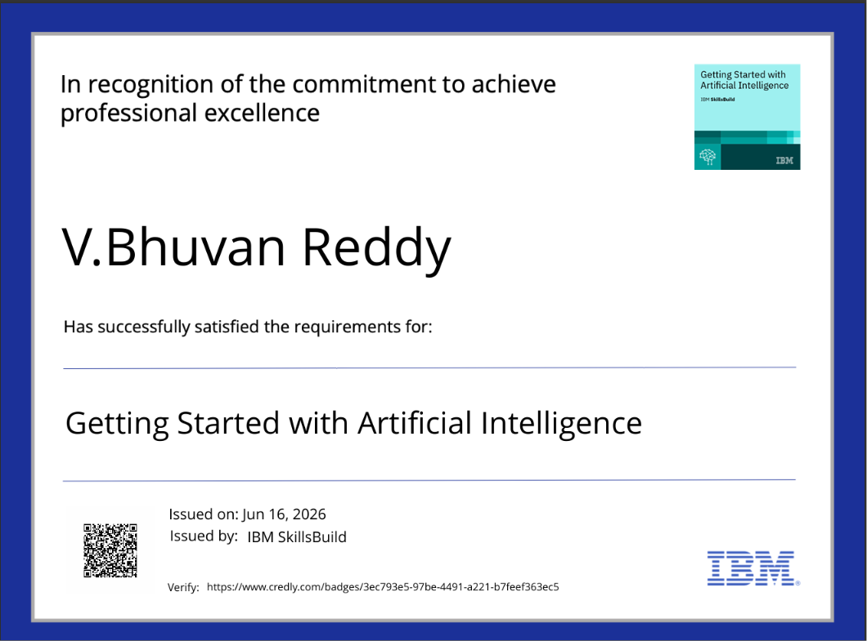
Certificates Earned:
Please add your credly certificate

Slide 18
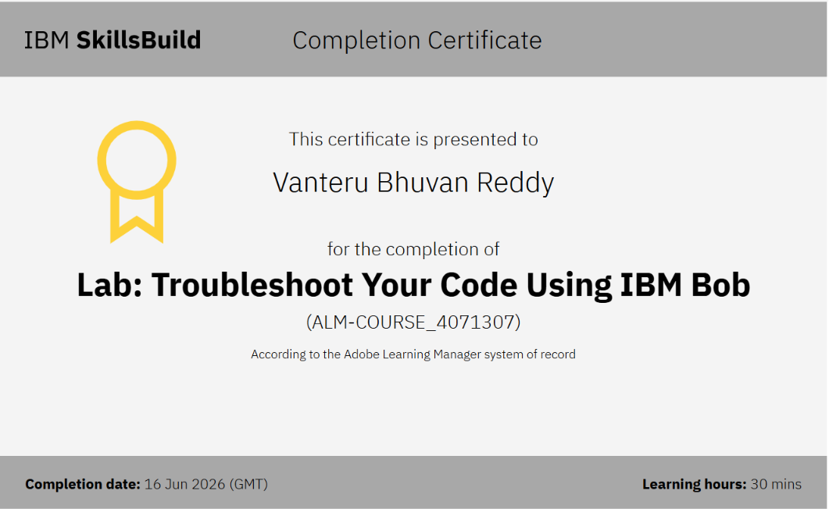
Certificates Earned:​
Add your IBM BOB Certificate

Slide 19
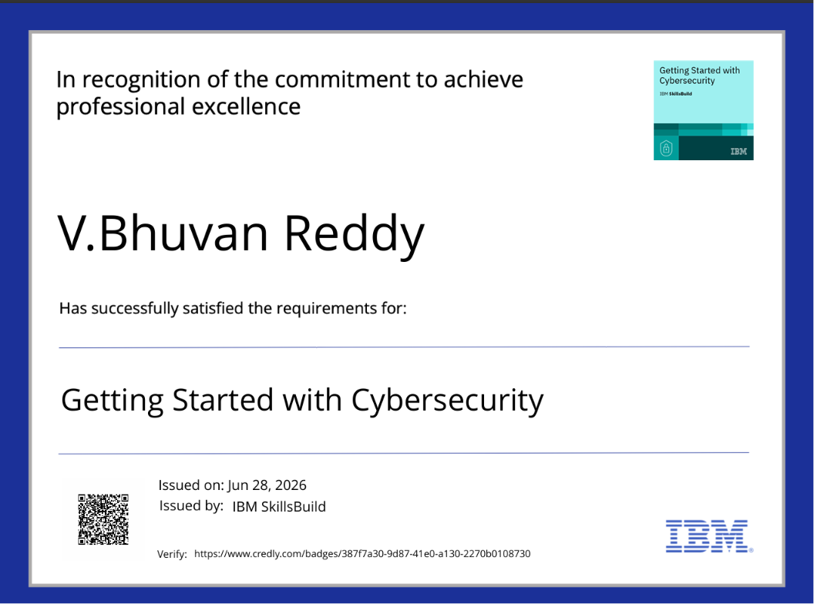
Additional Certificates Earned:

Slide 20
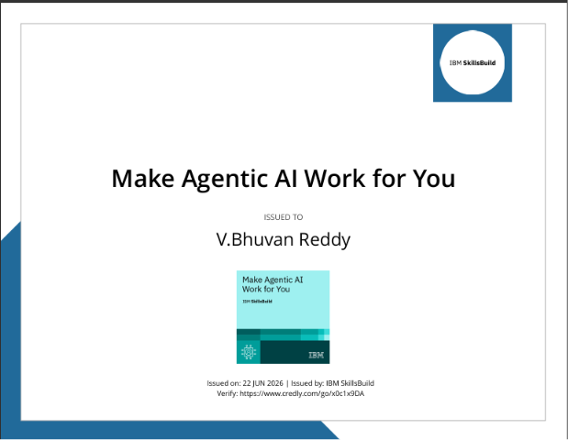
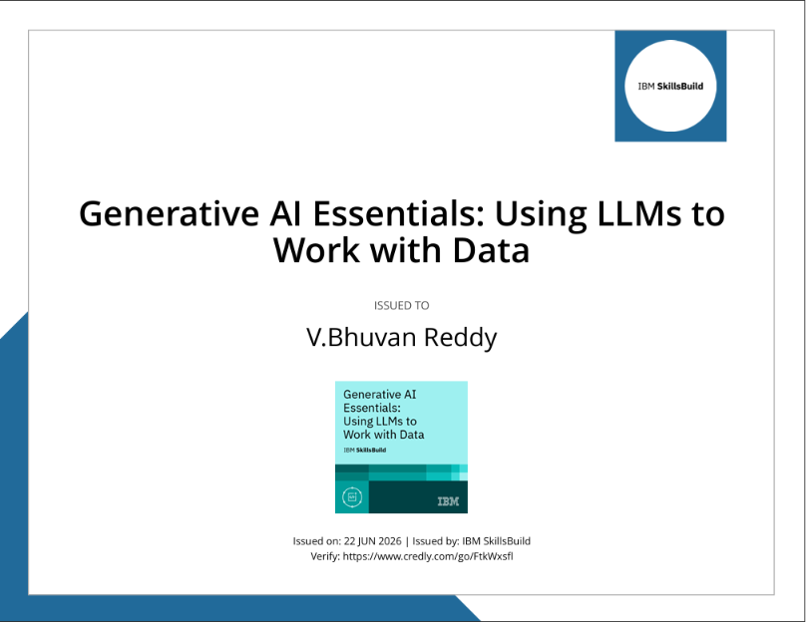
Make Agentic AI Work For You
Gen AI Essentials

Slide 21
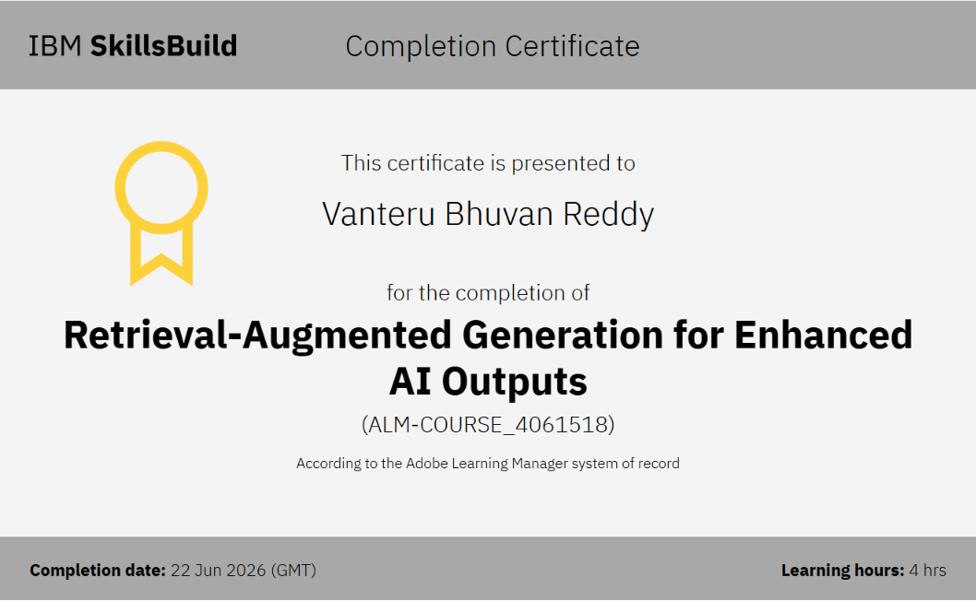
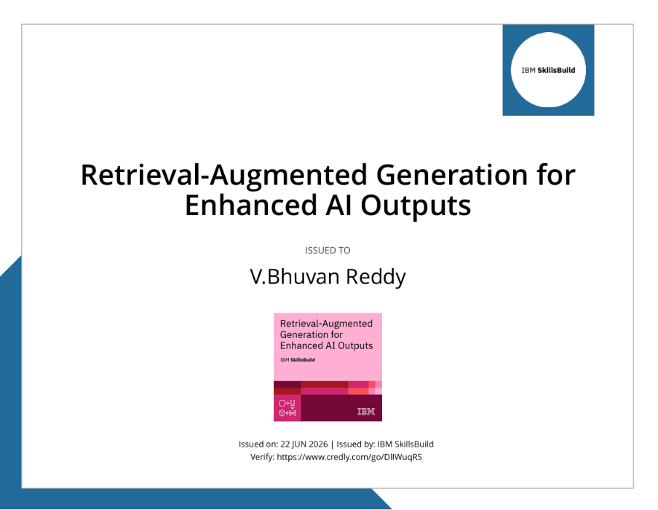
RAG Generation for Enhanced AI Outputs

Slide 22


